Slide 1
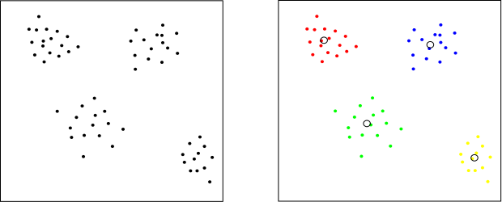
Clustering
Let’s suppose we give a child different objects to group. How does a child make a group? The child may group over the color, over the shape, over the hardness or softness of the objects etc. The basic idea here is that the child tries to find out similarities and dissimilarities between different objects and then tries to make a group of similar objects. This is called clustering, the method of identifying similar instances and keeping them together. In Other words, clustering identifies homogeneous subgroups among the observations.

Slide 2
K Means Clustering
K-Means is a clustering approach in which the data is grouped into K distinct non-overlapping clusters based on their distances from the K centres. The value of K needs to be specified first and then the algorithm assigns the points to exactly one cluster.

Slide 3
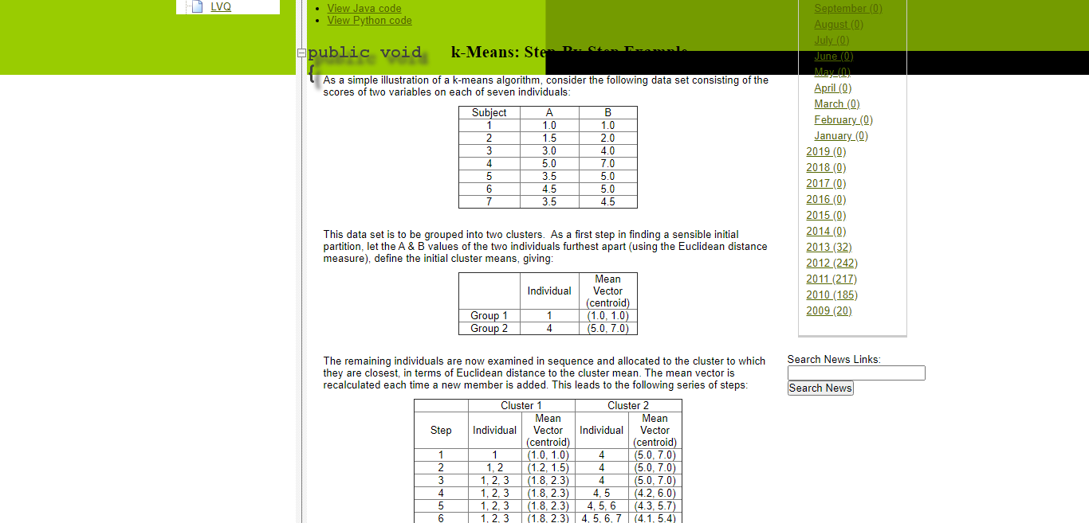
K Means Algorithm
This data set is to be grouped into two clusters. As a first step in finding a sensible initial partition, let the A & B values of the two individuals furthest apart (using the Euclidean distance measure), define the initial cluster means, giving:

Slide 4
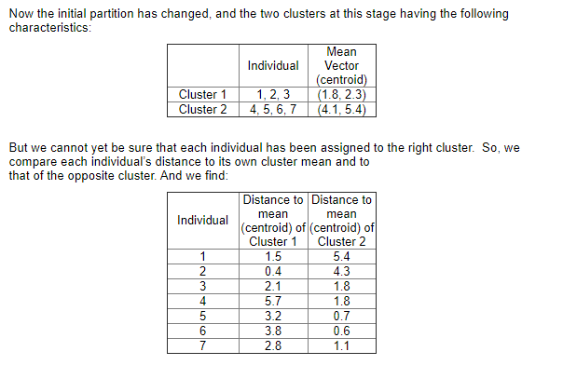

Slide 5
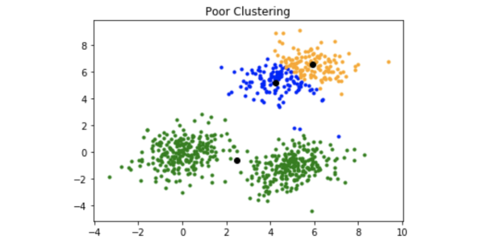
K-means Drawbacks

Slide 6
K-Mean ++
Randomly select the first centroid from the data points.
For each data point compute its distance from the nearest, previously chosen centroid.
Select the next centroid from the data points such that the probability of choosing a point as centroid is directly proportional to its distance from the nearest, previously chosen centroid. (i.e. the point having maximum distance from the nearest centroid is most likely to be selected next as a centroid)
Repeat steps 2 and 3 untill k centroids have been sampled

Slide 7
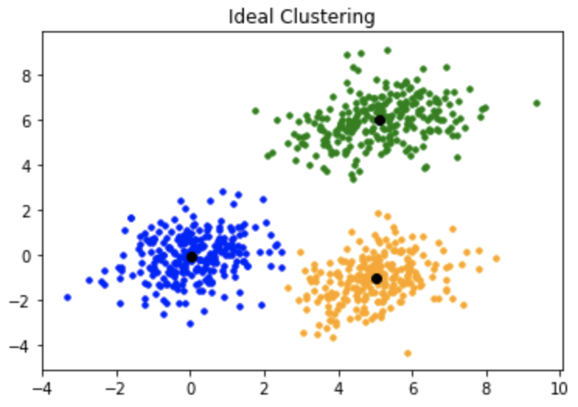
K-Mean ++

Slide 8
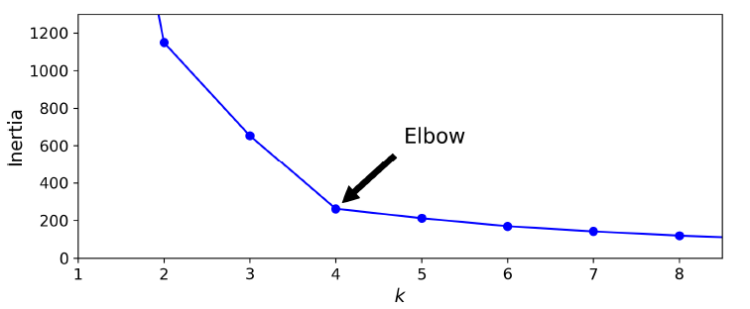
The Elbow-Method – Find out K value
This method is based on the relationship between the within-cluster sum of squared distances (WCSS Or Inertia) and the number of clusters.
It is observed that first with an increase in the number of clusters WCSS decreases steeply and then after a certain number of clusters the drop in WCSS is not that prominent.
The point after which the graph between WCSS and the number of clusters becomes comparatively smother is termed as the elbow and the number of clusters at that point are the optimum number of clusters as even after increasing the clusters after that point the variation is not decreasing by much

Slide 9
Decision Tree
Decision tree algorithm is one of the most versatile algorithms in machine learning which can perform both classification and regression analysis. It is very powerful and works great with complex datasets. Apart from that, it is very easy to understand and read. That makes it more popular to use. When coupled with ensemble techniques – which we will learn very soon- it performs even better. As the name suggests, this algorithm works by dividing the whole dataset into a tree-like structure based on some rules and conditions and then gives prediction based on those conditions.

Slide 10
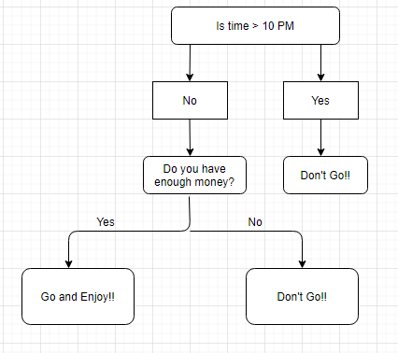
Let’s understand the approach to decision tree with a basic scenario. Suppose it’s Friday night and you are not able to decide if you should go out or stay at home. Let the decision tree decide it for you.

Slide 11
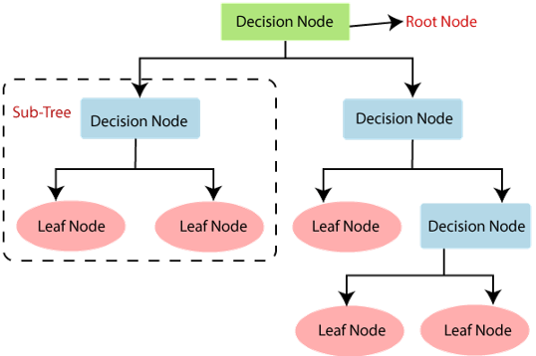
Terminology of Decision Tree

Slide 12
Terminology of Decision Tree
Root Node: It represents the entire population or sample and this further gets divided into two or more homogeneous sets.
Splitting: It is a process of dividing a node into two or more sub-nodes.
Decision Node: When a sub-node splits into further sub-nodes, then it is called the decision node.
Leaf / Terminal Node: Nodes do not split is called Leaf or Terminal node.
Branch / Sub-Tree: A subsection of the entire tree is called branch or sub-tree.
Parent and Child Node: A node, which is divided into sub-nodes is called a parent node of sub-nodes whereas sub-nodes are the child of a parent node

Slide 13
Algorithm

Slide 14
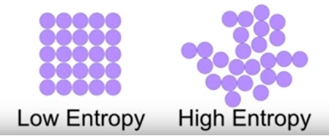
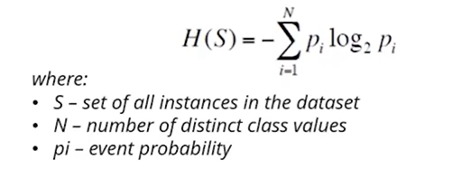
Entropy
Entropy is the measure of randomness in the data. In other words, it gives the impurity present in the dataset.

Slide 15
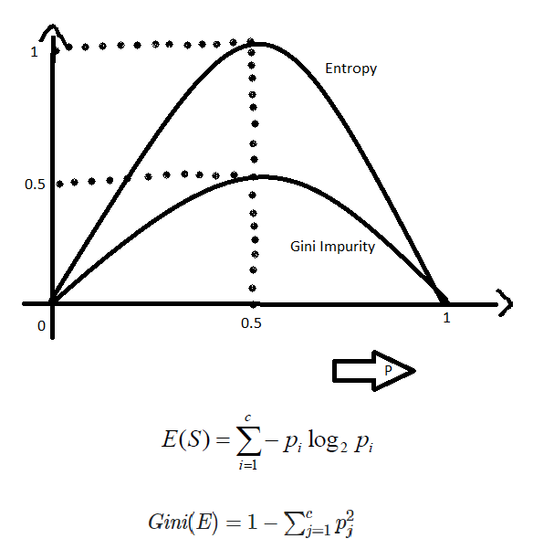
Gini Index / Gini impurity
The Gini Index or Gini Impurity is calculated by subtracting the sum of the squared probabilities of each class from one.

Slide 16

Information gain
Information gain calculates the decrease in entropy after splitting a node. It is the difference between entropies before and after the split. The more the information gain, the more entropy is removed.

Slide 17
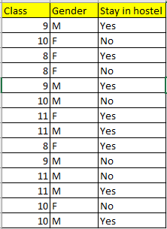
Lets understand with the help of example

Slide 18
Advantages of Decision Tree:
• It can be used for both Regression and Classification problems.
• Decision Trees are very easy to grasp as the rules of splitting is clearly mentioned.
• Complex decision tree models are very simple when visualized. It can be understood just by visualizing.
• Scaling and normalization are not needed.
Disadvantages of Decision Tree:
• Probability of overfitting is very high for Decision Trees.
• It takes more time to train a decision tree model than other classification algorithms.

Slide 19
Important hyperparameters
Parameters
* criterion : string, optional (default="gini")
The function to measure the quality of a split. Supported criteria are
"gini" for the Gini impurity and "entropy" for the information gain.
* max_depth : int or None, optional (default=None)
The maximum depth of the tree. If None, then nodes are expanded until
all leaves are pure or until all leaves contain less than
min_samples_split samples.
* min_samples_split : int, float, optional (default=2)
The minimum number of samples required to split an internal node:
- If int, then consider `min_samples_split` as the minimum number.
- If float, then `min_samples_split` is a fraction and
`ceil(min_samples_split * n_samples)` are the minimum
number of samples for each split.

Slide 20
Important hyperparameters
* min_samples_leaf : int, float, optional (default=1)
The minimum number of samples required to be at a leaf node.
A split point at any depth will only be considered if it leaves at
least ``min_samples_leaf`` training samples in each of the left and
right branches. This may have the effect of smoothing the model,
especially in regression.
- If int, then consider `min_samples_leaf` as the minimum number.
- If float, then `min_samples_leaf` is a fraction and
`ceil(min_samples_leaf * n_samples)` are the minimum
number of samples for each node.

Slide 21
Important hyperparameters
* max_features : int, float, string or None, optional (default=None)
The number of features to consider when looking for the best split:
- If int, then consider `max_features` features at each split.
- If float, then `max_features` is a fraction and
`int(max_features * n_features)` features are considered at each
split.
- If "auto", then `max_features=sqrt(n_features)`.
- If "sqrt", then `max_features=sqrt(n_features)`.
- If "log2", then `max_features=log2(n_features)`.
- If None, then `max_features=n_features`.
Note: the search for a split does not stop until at least one
valid partition of the node samples is found, even if it requires to
effectively inspect more than ``max_features`` features.

